Slide 1
Digital Measures Replacement

Slide 2
Current Systems
UB uses two separate faculty annual report systems
eCV
School of Medicine
School of Dentistry
Activity Insight (Digital Measures)
All other units

Slide 3
Issues with Reporting Systems
eCV written in Visual Fox Pro; Microsoft plans to discontinue support
Digital Measures interface poorly designed
No ability to automatically load publication data
No ability to automatically load grants & contracts data
Aggregated data reports for Deans and Chairs not available

Slide 4
Alternatives Considered
Improve Digital Measures
Not viable option (proprietary software)
Rewrite eCV
Indiana FAR considered better in-house solution
Indiana U. Faculty Annual Report (FAR)
Thompson Reuters Research in View
Live demo – Nov 10th
11:30-1:00 Faculty and Department Administrator Session -- session will focus on the annual report part
2:00-3:30 Session for Upper Level Administrators, Interested IT Staff, Library Administrators, Deans, OIA Staff, etc

Slide 5
Indiana FAR
Java based - - built on the Kuali framework
Access to source code – free
Total cost of ownership to consider
Faculty Annual Reports
Simple, easy-to-use interface
No real analysis capability, wasn’t designed for that
Customizable (we can modify the code)
Tie in to existing University data sources
Courses
Grants (we need extract from our own systems)
Ingest publications automatically (not now but maybe can be added)

Slide 6
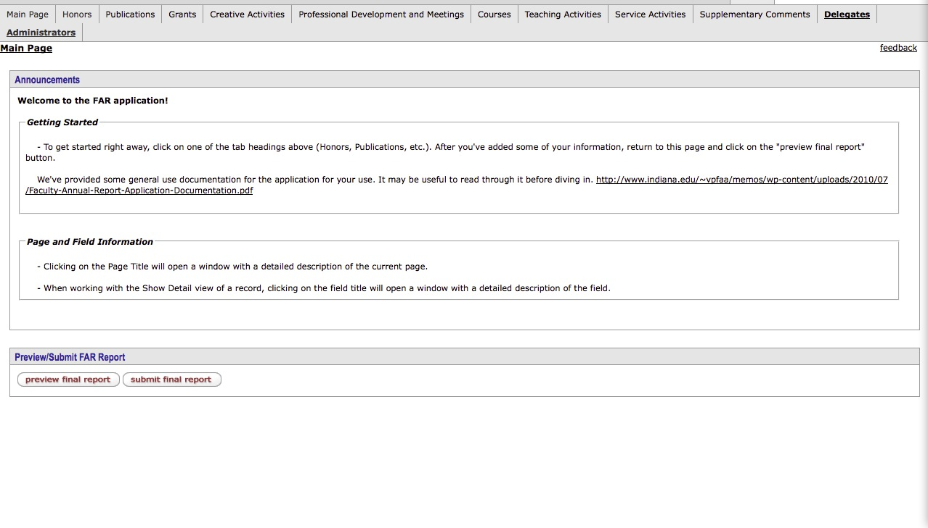
Home Page

Slide 7
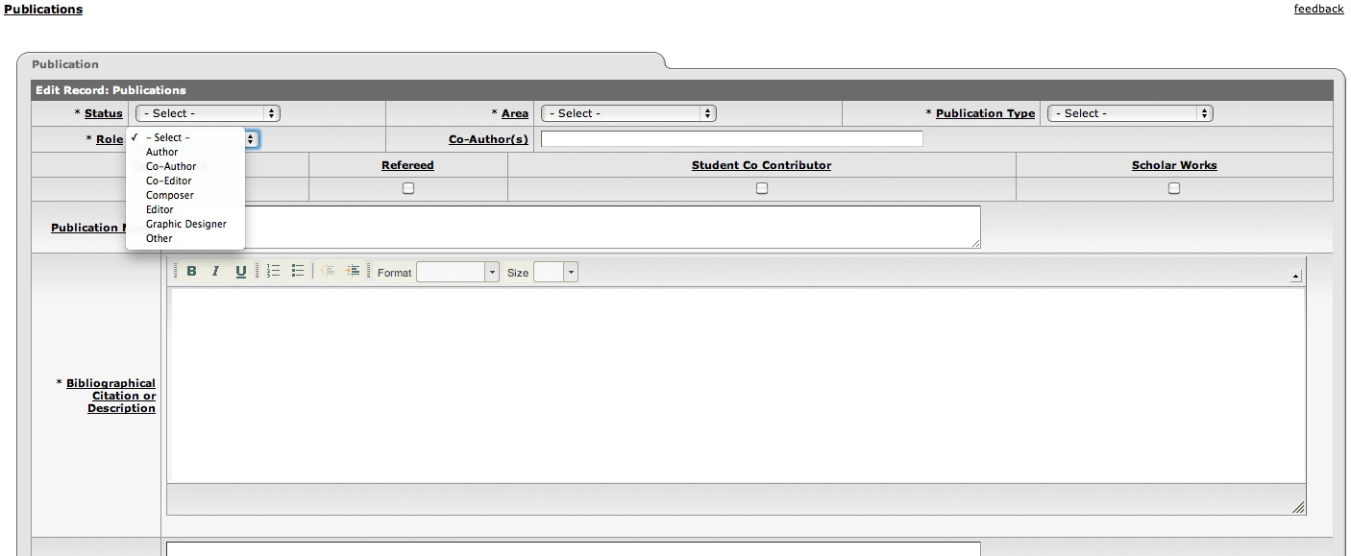
Publications
Can cut and paste info
Could likely import current faculty data from DM

Slide 8
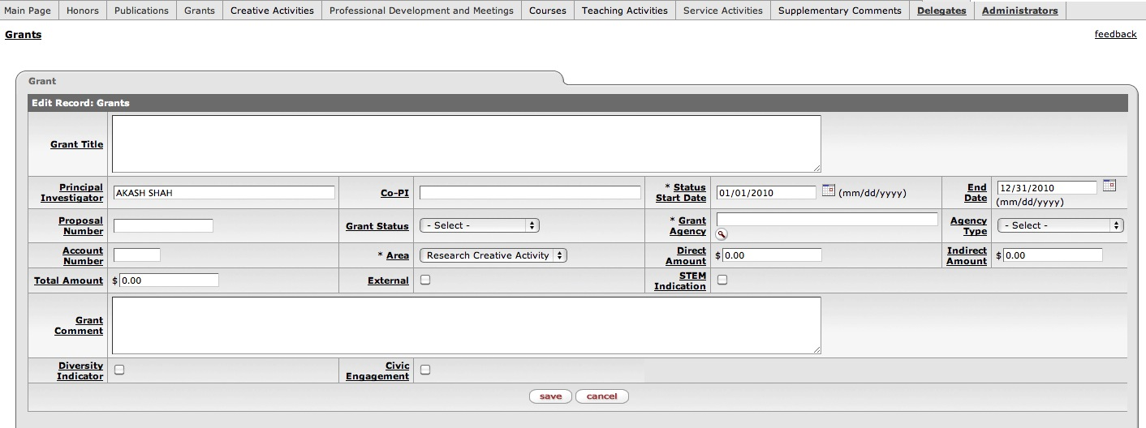
Grants (auto populated by PI)

Slide 9
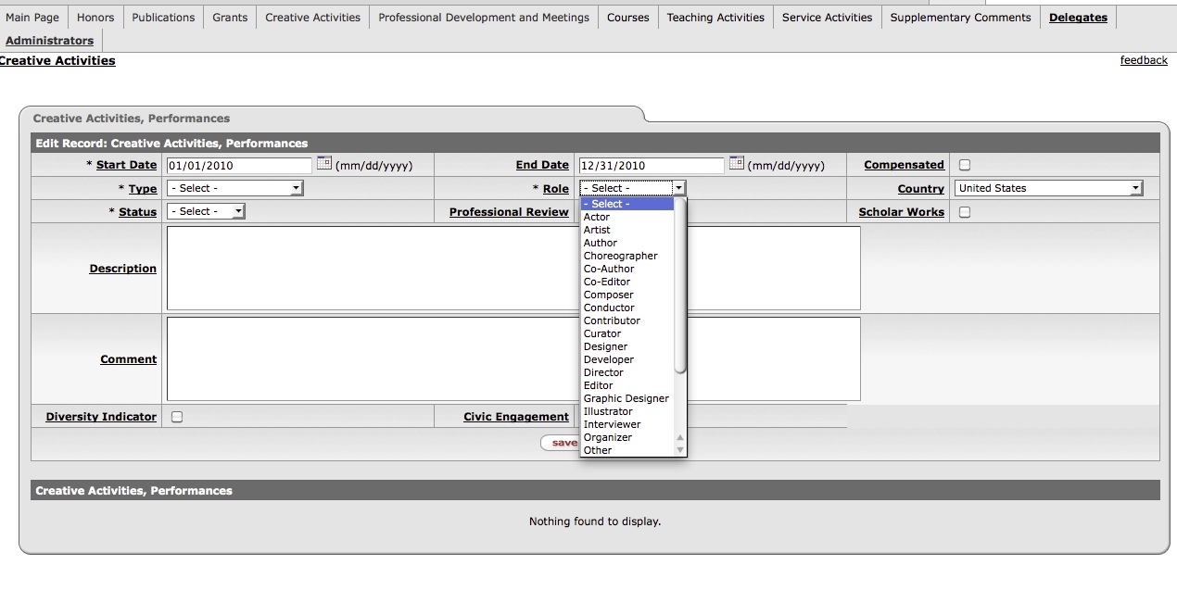
Creative Activities

Slide 10
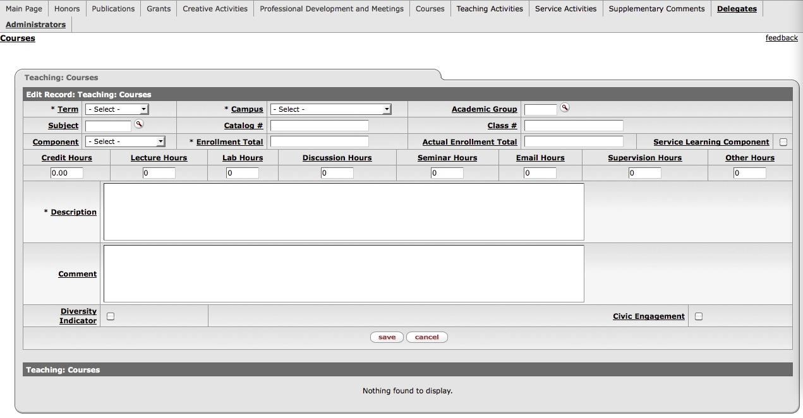
Courses (auto populated from HUB)

Slide 11
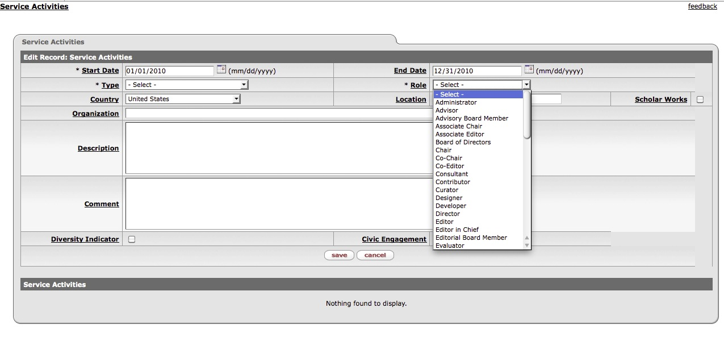
Service Activities

Slide 12
Research in View
Thompson – Reuters
Hosted Solution
Minimal faculty input
Much more than a Faculty Annual Report Tool
Analysis tool for all levels of university
InCites included
Annual license fee

Slide 13
Enterprise-wide research management system
Hosted solution provides a standard data model and tools to build and maintain profiles of faculty service, teaching, and research activities.
Supports faculty and administrative reporting and workflows such as biosketches, CVs, web sites, annual review, and strategic reports.
Integrated with Web of Science and ScienceWire patent, book, and grant data sources, ResearcherID, and your institutional data systems.
Allows for importing content from HR systems, Awards, repositories, and external data.

Slide 14
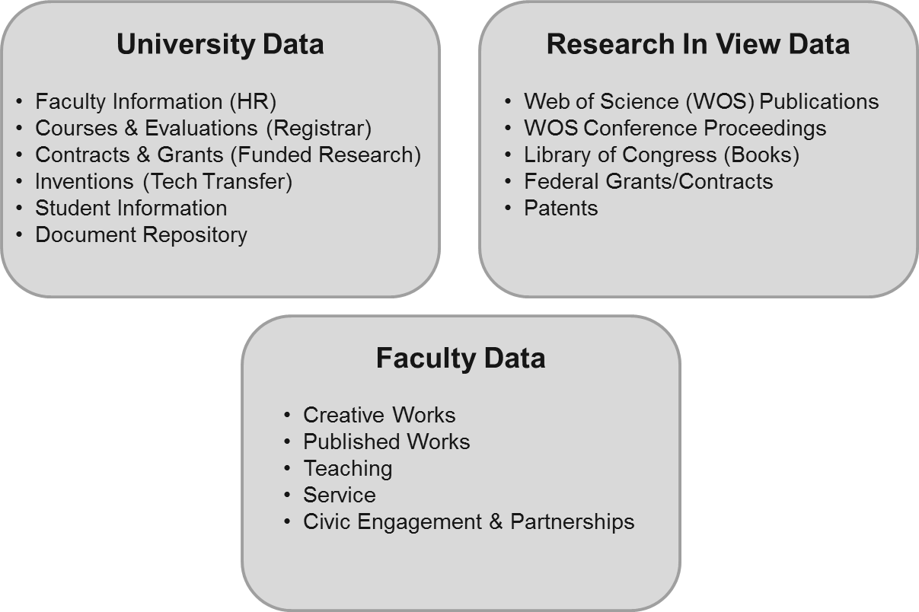
Faculty profile data sources
Integration with your current systems via APIs
Thomson Reuters data sources minimize manual input from faculty
Notes:
Research In View leverages university data, as well as external data to make up the profile. We’ll see some ways in which the addition of the faculty data could be automated.

Slide 15
Faculty profile features
Regular alerts for new articles, grants, and patents matched to profile
Tools to verify and add data to profile by user or proxy
Settings to regulate sharing of profile data
Data export to CV, Reports, ResearcherID, and InCites
University data sources are used to define the list of active faculty and staff

Slide 16
Example of faculty profile

Slide 17
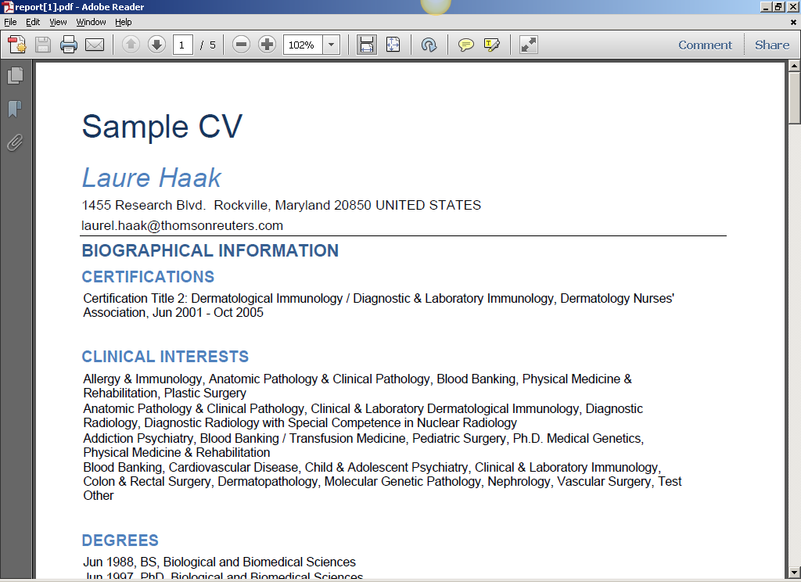
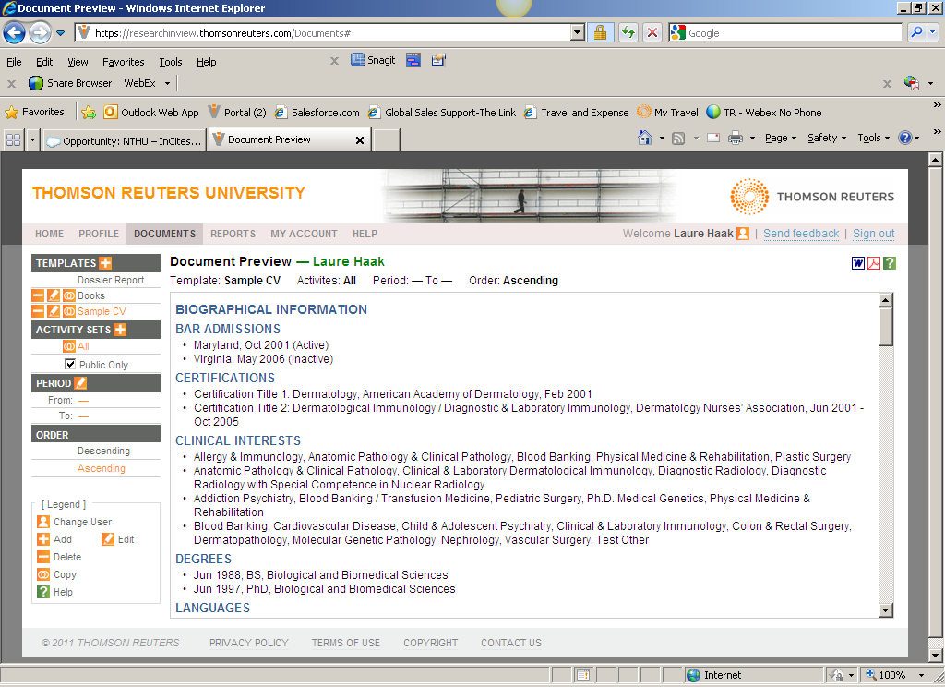
Faculty members can quickly generate documents
Choose a document template or choose specific activities and years to create a custom document .

Slide 18
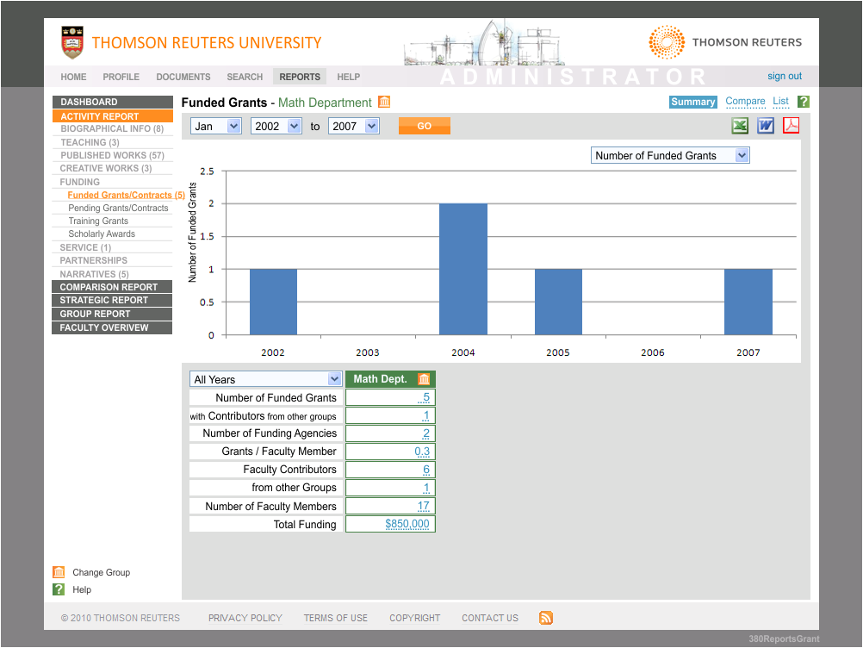
Dashboards synthesize data for evaluation decisions
Instant overviews of departments or individuals
Detailed views of all activities
E.g. Funded Grants:
How has funding for this department changed over time?
Where is the funding coming from?
Are collaborators involved?
How does funding for this department compare with other departments?

Slide 19
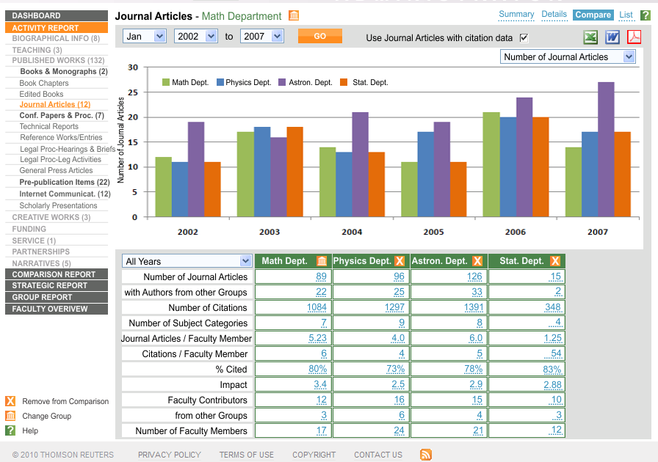
Department comparison reports
Conduct inter-department comparisons across all activity areas

Slide 20
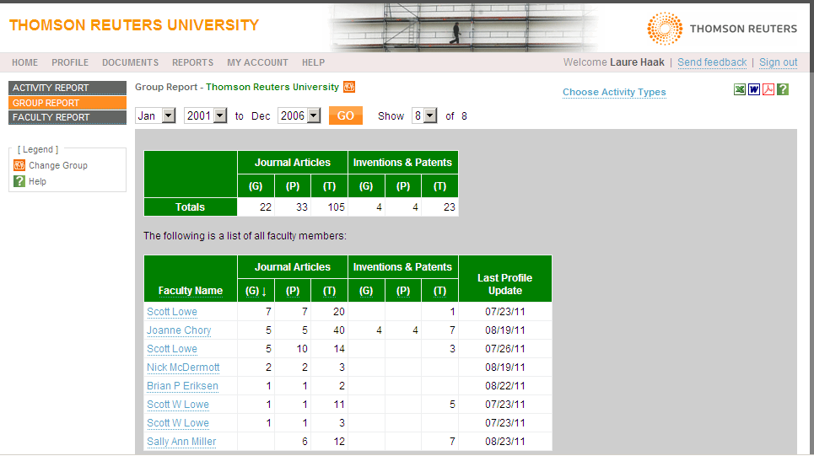
Group Reports (strategic strengths)
Run group reports to compare activities across faculty members

Slide 21
Research In View Development Path –
EARLY 2012
COMMON EUROPEAN RESEARCH INFORMATION FORMAT (CERIF) IMPORT AND EXPORT Import publication information in CERIF standard from your existing data sources to automatically populate
LATE 2011
INCITES INTEGRATION Link directly to InCites to analyze institutional productivity and benchmark output
MID 2012
DIRECT CONNECT TO INSTITUTIONAL REPOSITORY Search and deposit information between your institution’s data repository and Research In View – and coming soon, Open Access repositories
FUNDED RESEARCH DATABASE INTEGRATION Integrate your existing funded research database directly into profiles with ease
REGISTRAR INTEGRATION Import information from your institution’s registrar’s office into Research In View profiles
CASRAI AND VIVO SUPPORT Facilitate profiles and ensure consistency using a single data source
REPORTING ENHANCEMENTS Various enhancements including comparison reports and dashboards to for at-a-glance visual overviews of department activity and performance statistics
CV PARSER / READER Scan existing CVs and import information into RIV faculty profiles, reducing the manual process of profile population
TAGGING PROFILES AND PUBLICATIONS Tag Research In View items for automatic inclusion in government and accreditation reports
IMPORT FROM ENDNOTE Add EndNote publication lists directly into Research In View profiles
FACULTY PROFILES SEARCH Promote networking, collaboration and outreach with advanced search tools for public-facing profiles

Slide 22
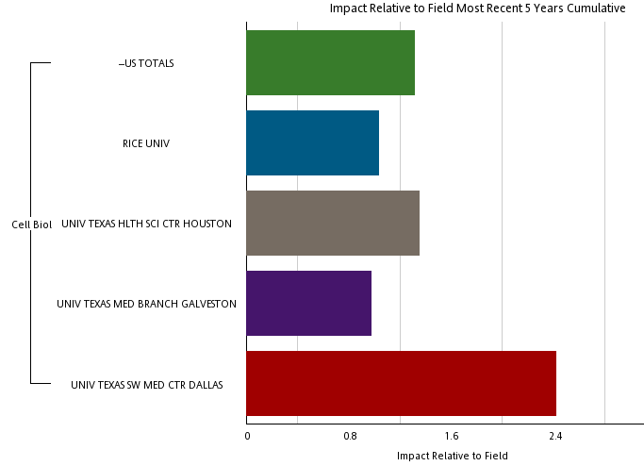
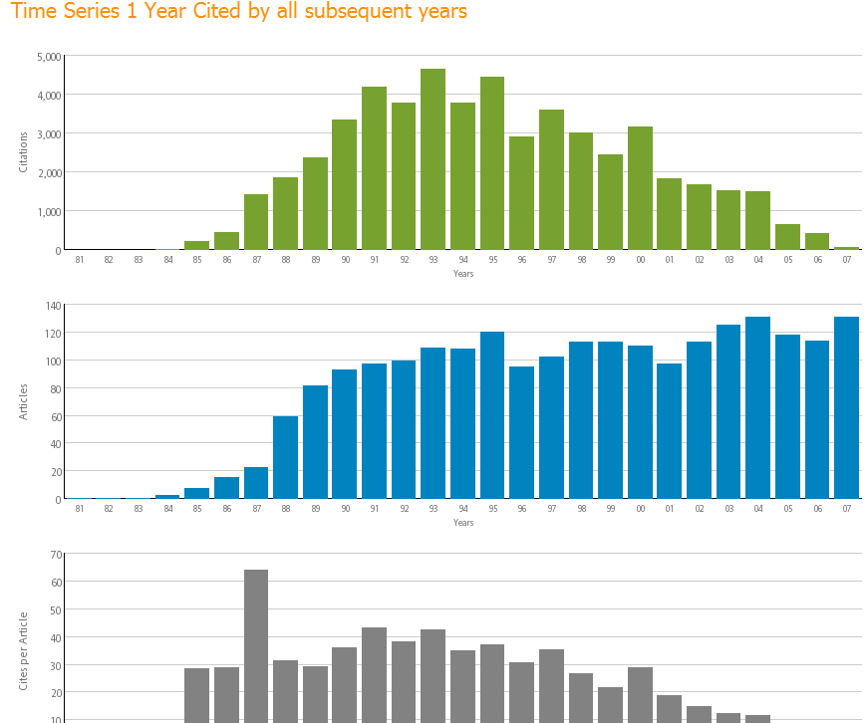
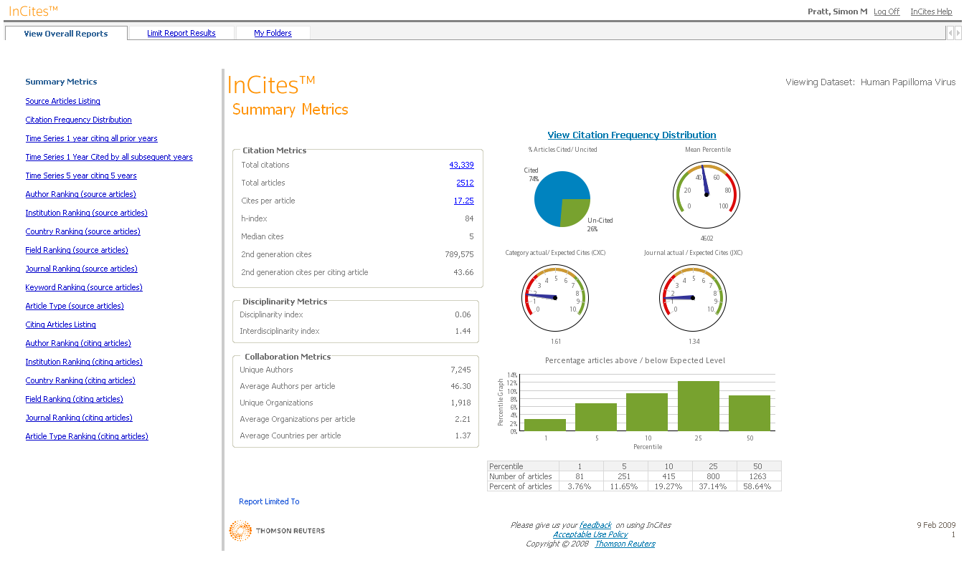
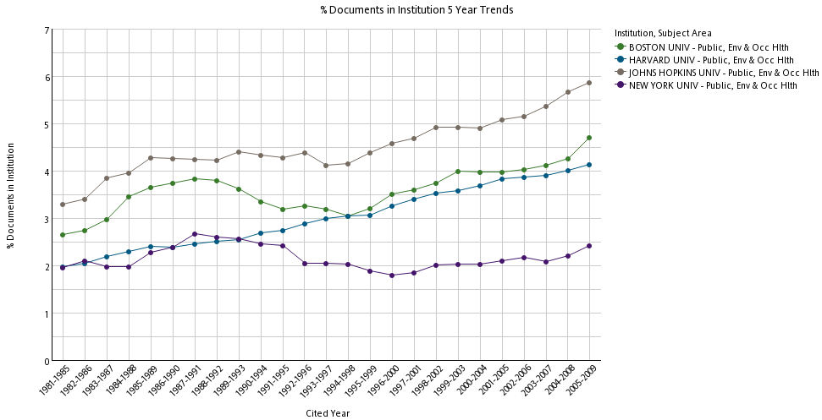
Comparison Across Institutions
InCites is a web-based research evaluation tool designed to track trends on the field, country, and institution level, to enable detailed bibliometric analysis and reporting on the publications important to you.

Slide 23
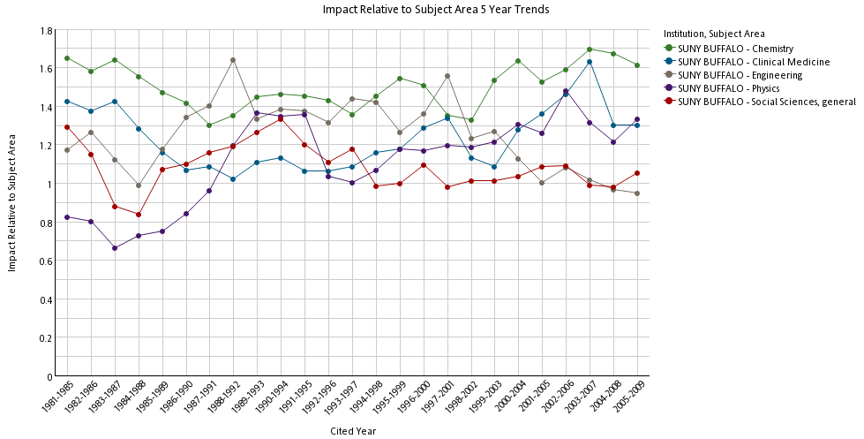
Measure program strength within UB
Citation impact in Physics has risen and fallen dramatically in recent years
Relative Impact : Citation impact normalized for field average citation rate (= 1.0)

Slide 24
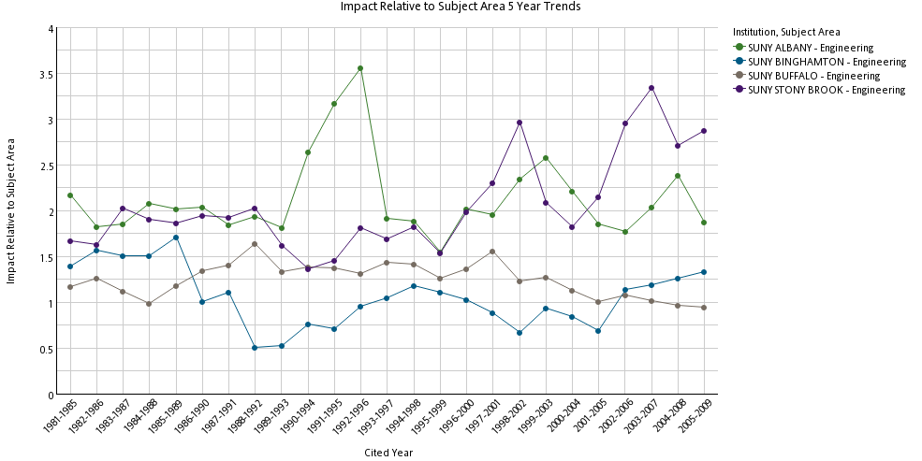
Drill down to a comparison with other institutions: Engineering
Relative Impact in Engineering: citation impact normalized for field average citation rate (=1.0)

Slide 25
Comparison of Options
 | Interface | Grants & Contracts | Publications | Aggregate Reporting | Cost
Digital Measures | Clunky | Accepts XML, Custom Development | Accepts XML, Custom Development Tedious Entry | Poor, Could Custom Develop | ~$30k per year, some Staff Time
eCV | TBD | Custom Development | Custom Development | Custom Development | Lots of Staff Time
FAR | Simple, Tabbed | Custom Development | Custom Development | Custom Development | Some Staff Time
Research in View | TBD | Accepts data via API, had major Federal | Built-in | TBD | ~$75K per year, some Staff Time

Slide 26
eCV
Would need to completely rewrite eCV in near future
In-house development required but we could spec out exactly what we want
Could extract journal publications from Web of Science and load into eCV via custom programming
Could transform data from our grants and publications system and load into eCV via custom programming
Can spec and write custom reports

